Slide 1
Mycelium-Based Packaging
Naturally Grown. Industrially Ready.

Slide 2
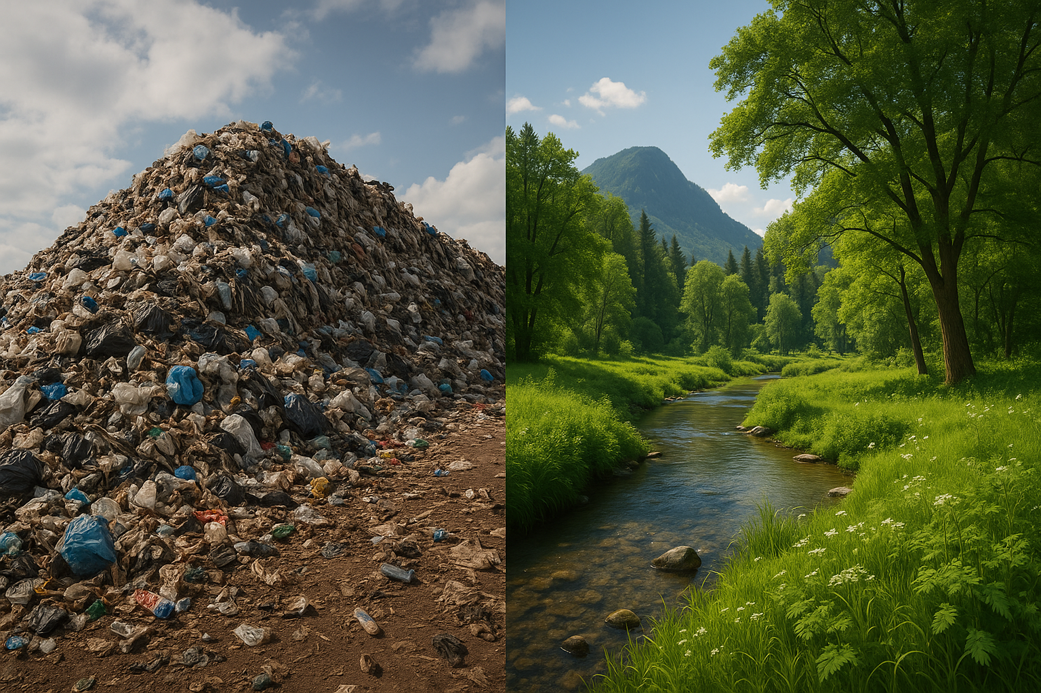
The Problem:
Waste is Slowly Killing the Planet
“We’ve been designing waste for permanence. It’s time we grow it for disappearance.”
Anually:
166 mln tonnes of plastic packaging waste
423 mln tonnes of paper and cardboard waste
Plastic lasts 1,000+ years in soil
Identified 189 dangerous chemicals in plastics and paper packaging:
carcinogens
neurotoxins
hormone-disrupting compounds
Microplastics in food chain NOW!

Slide 3
Our Solution:
Grown Packaging That Disappears
Non-Toxic
Insulator
Fire-resistant
100 % Biodegradable
Soundproof
Hydrophobic
Strong and Durable
“It’s not produced. It’s cultivated.”

Slide 4
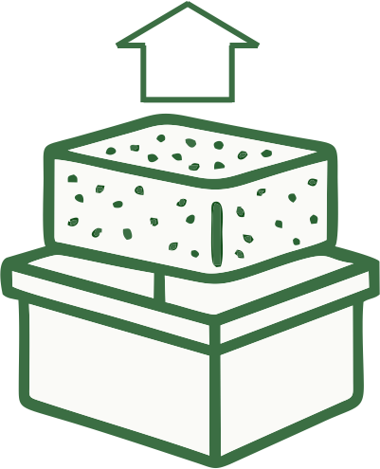
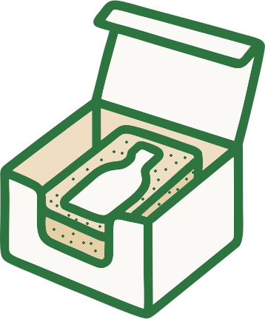
Mycelium:
Nature’s Smartest Material
Hemp Waste
Inoculation
Mold
Growth
Thermal Treatment
Product
Biodegradation
Soil Enrichment
“Inspired by fungi, perfected for industry.”

Slide 5
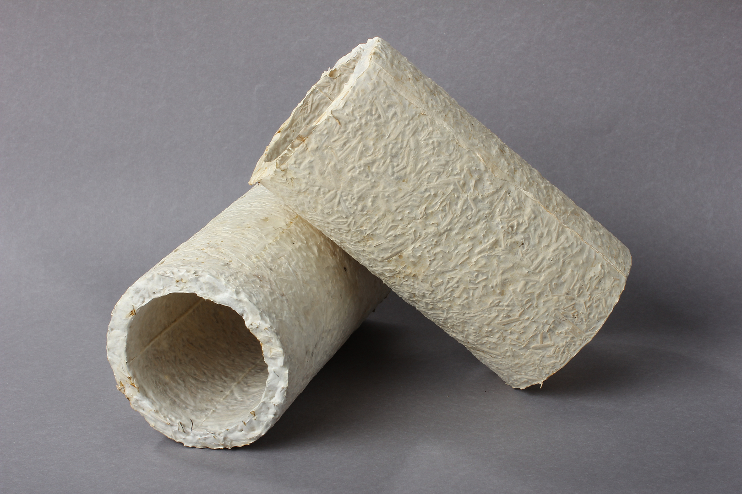
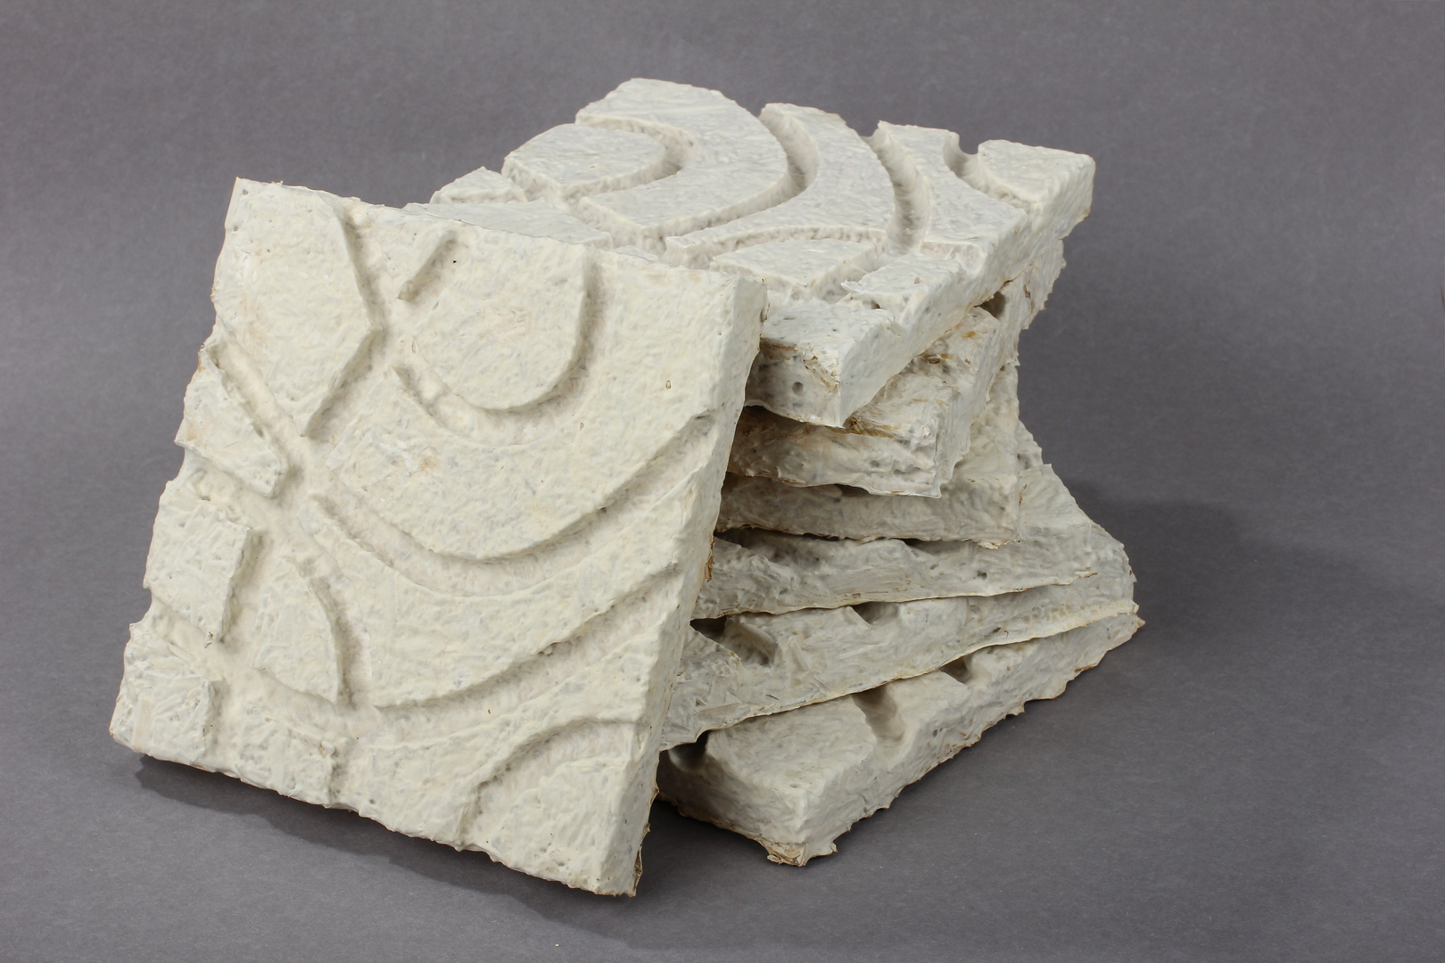
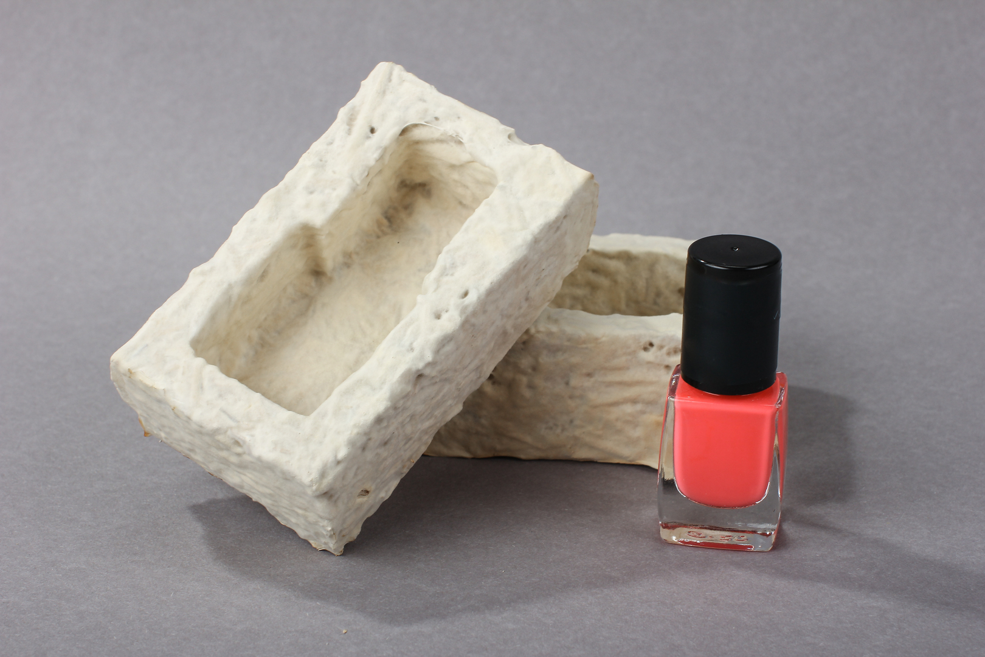
Our Products:
What We’ve Already Grown
Tubes
Perfect for protection
Tested with organic glue
Panels
Acoustic soundproofing
Insulative properties
Shell Packs
Sway-like texture
Custom grown
“Grown in a garage.
Ready for the world.

Slide 6
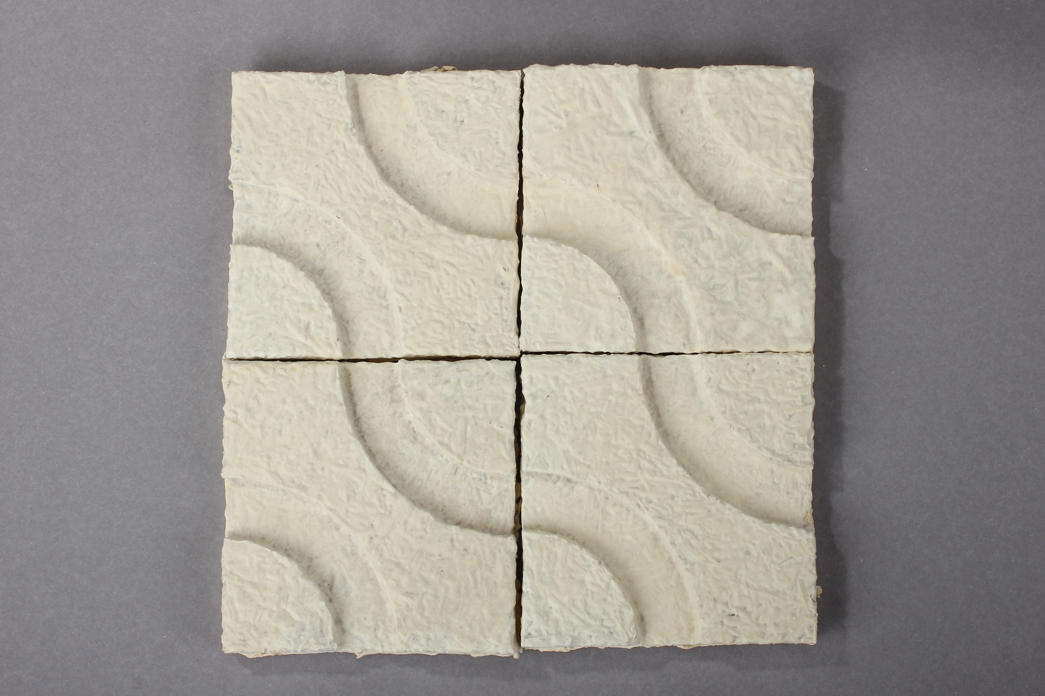
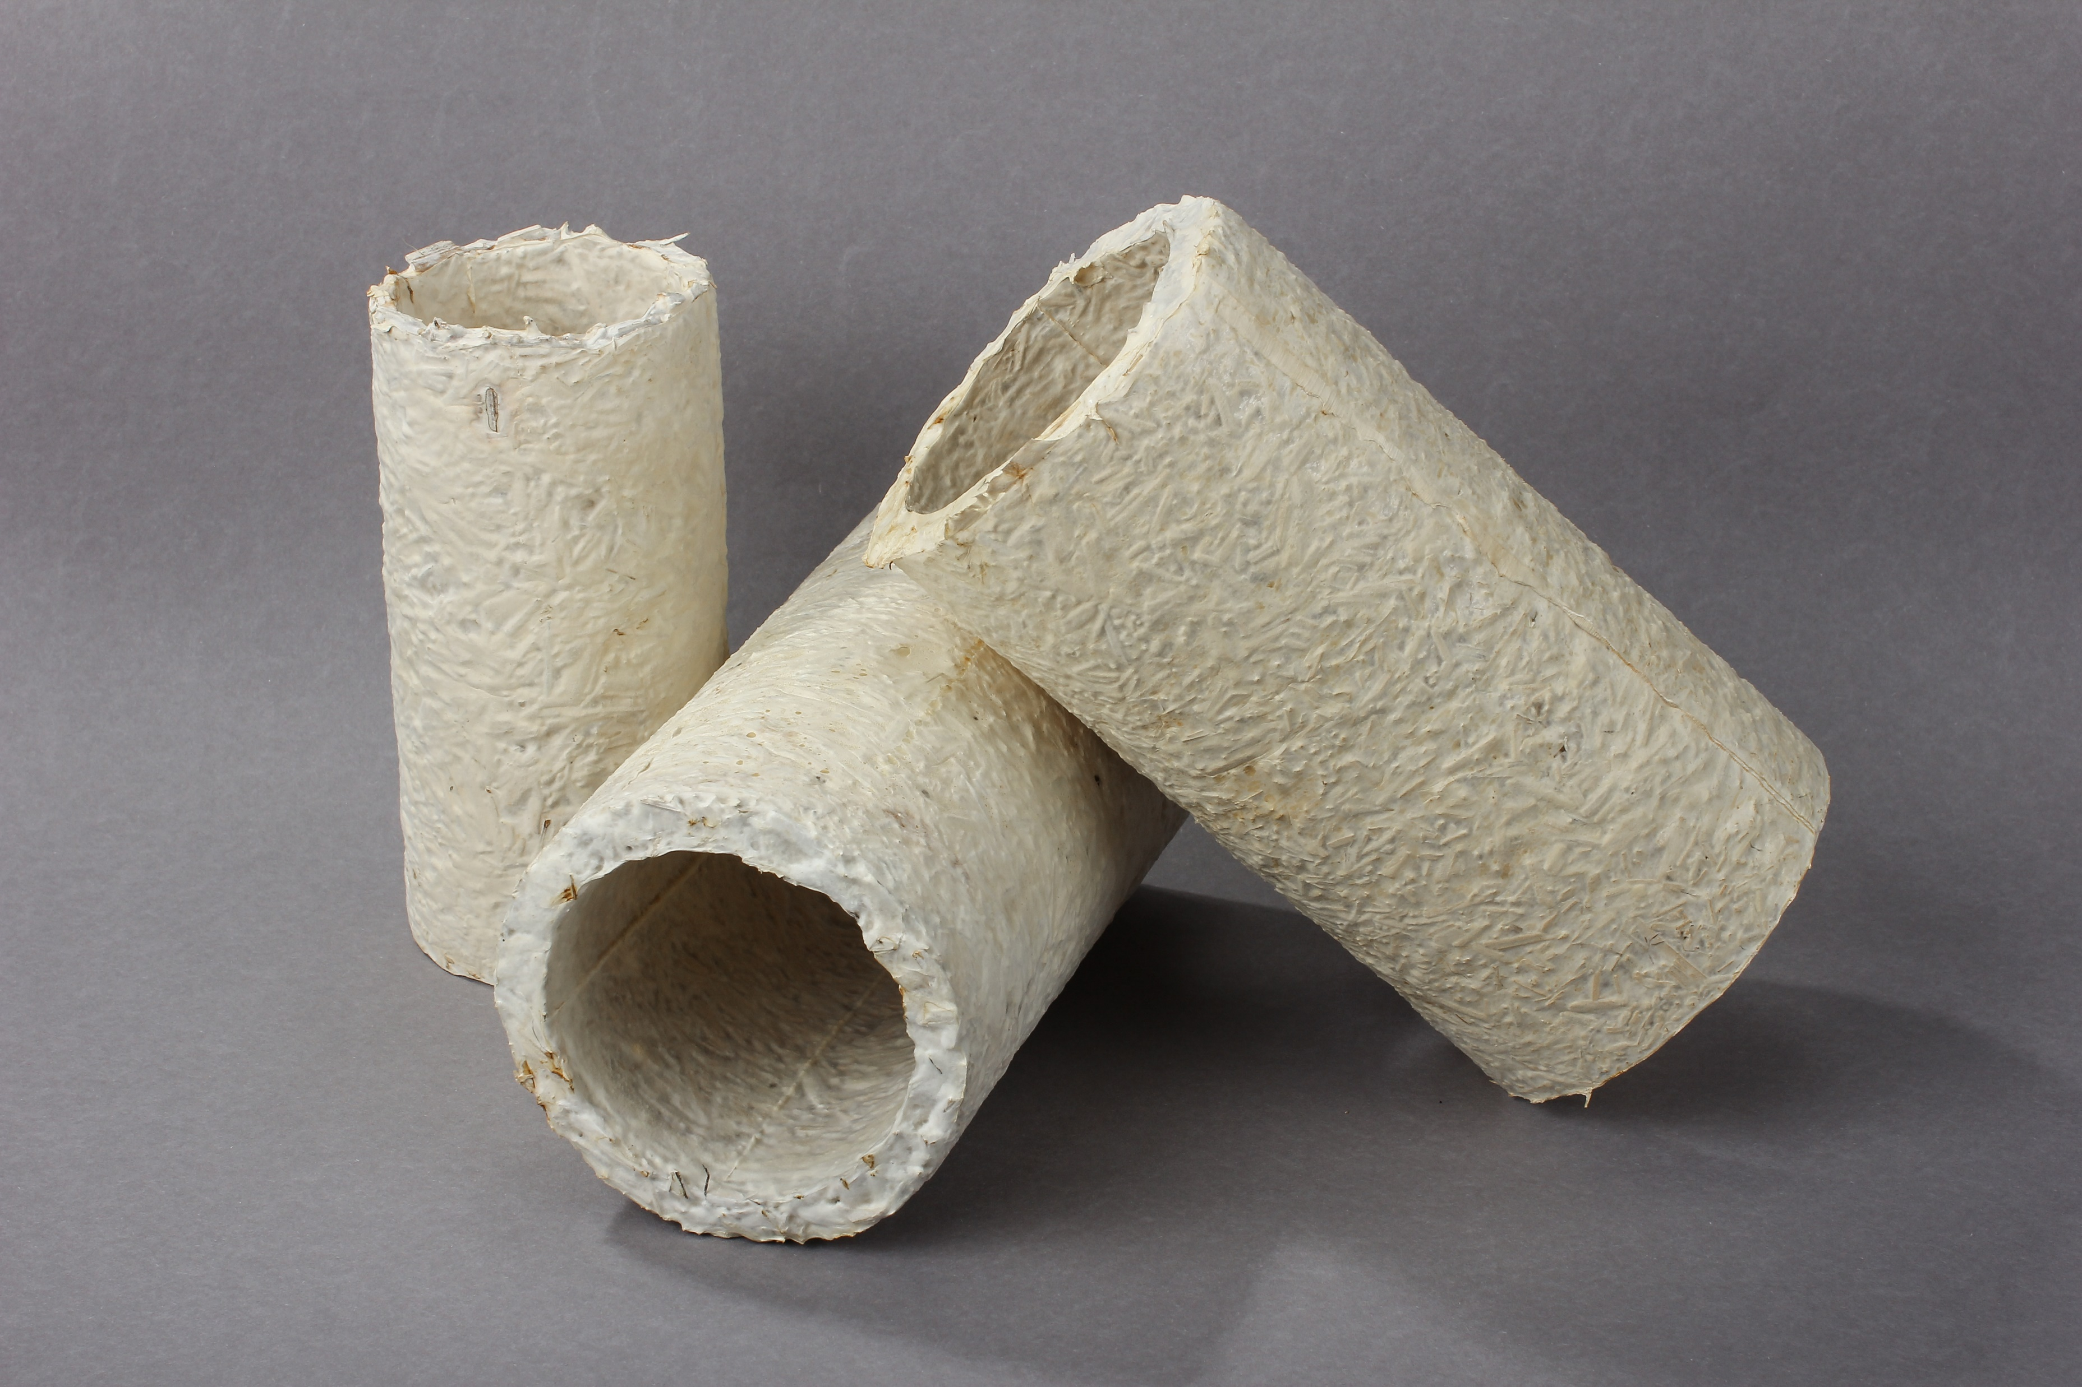
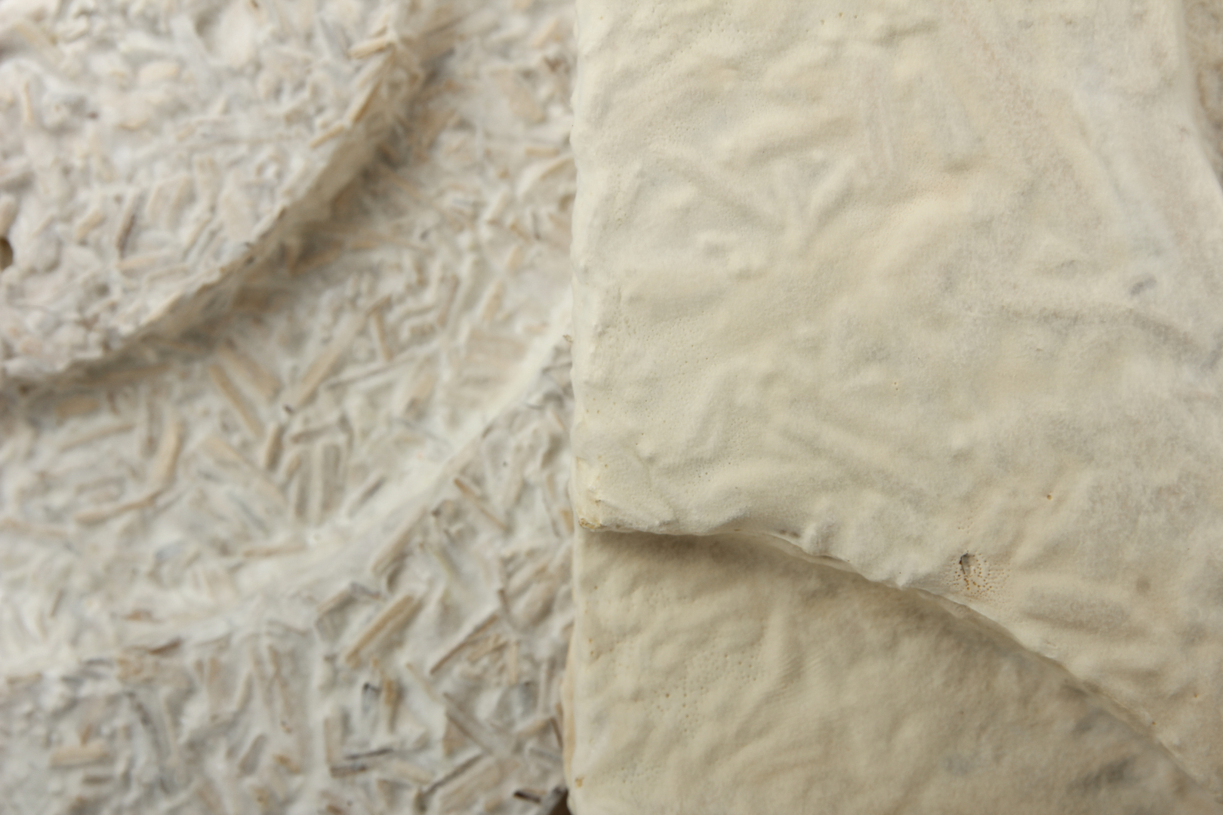
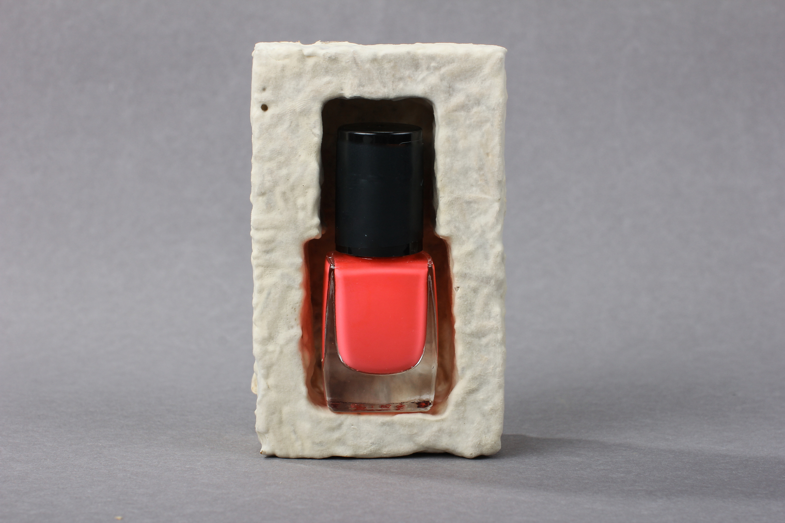
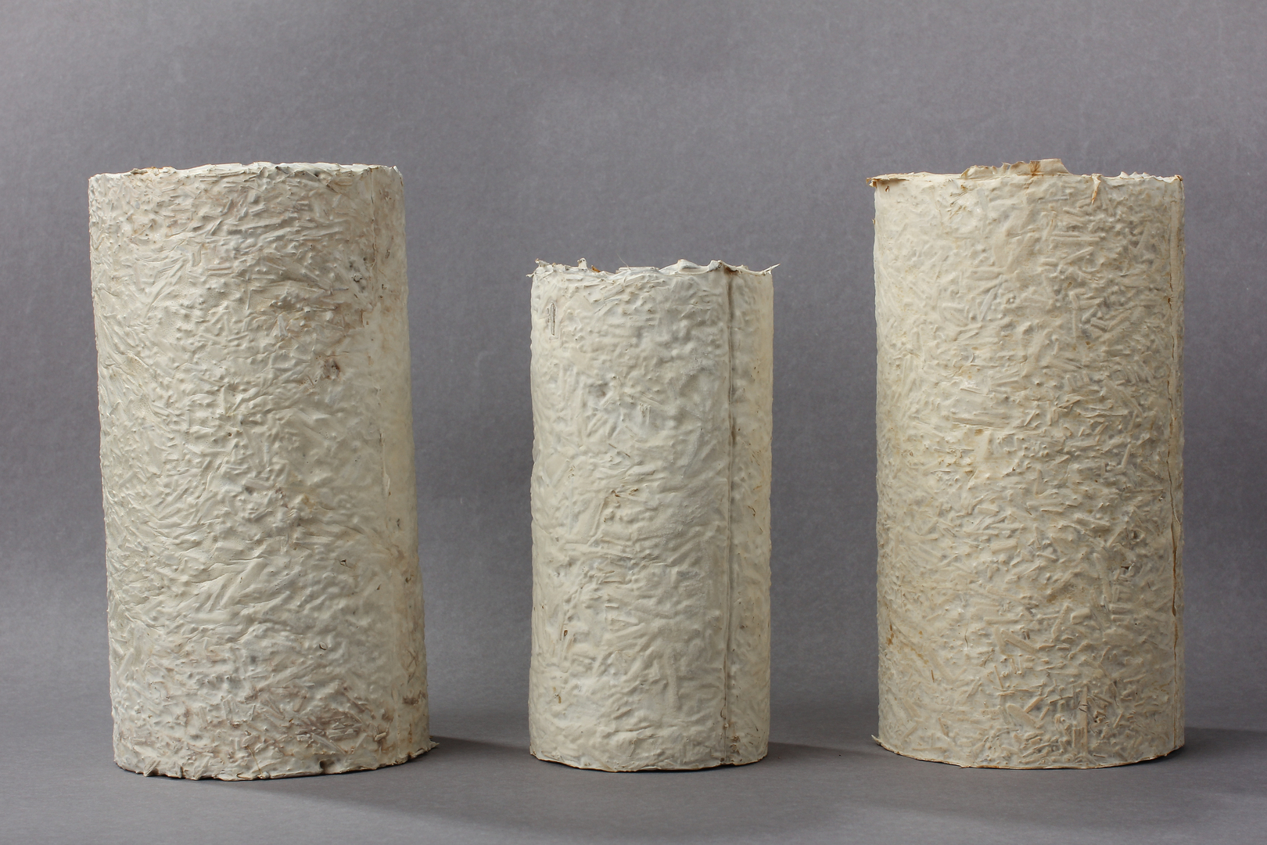
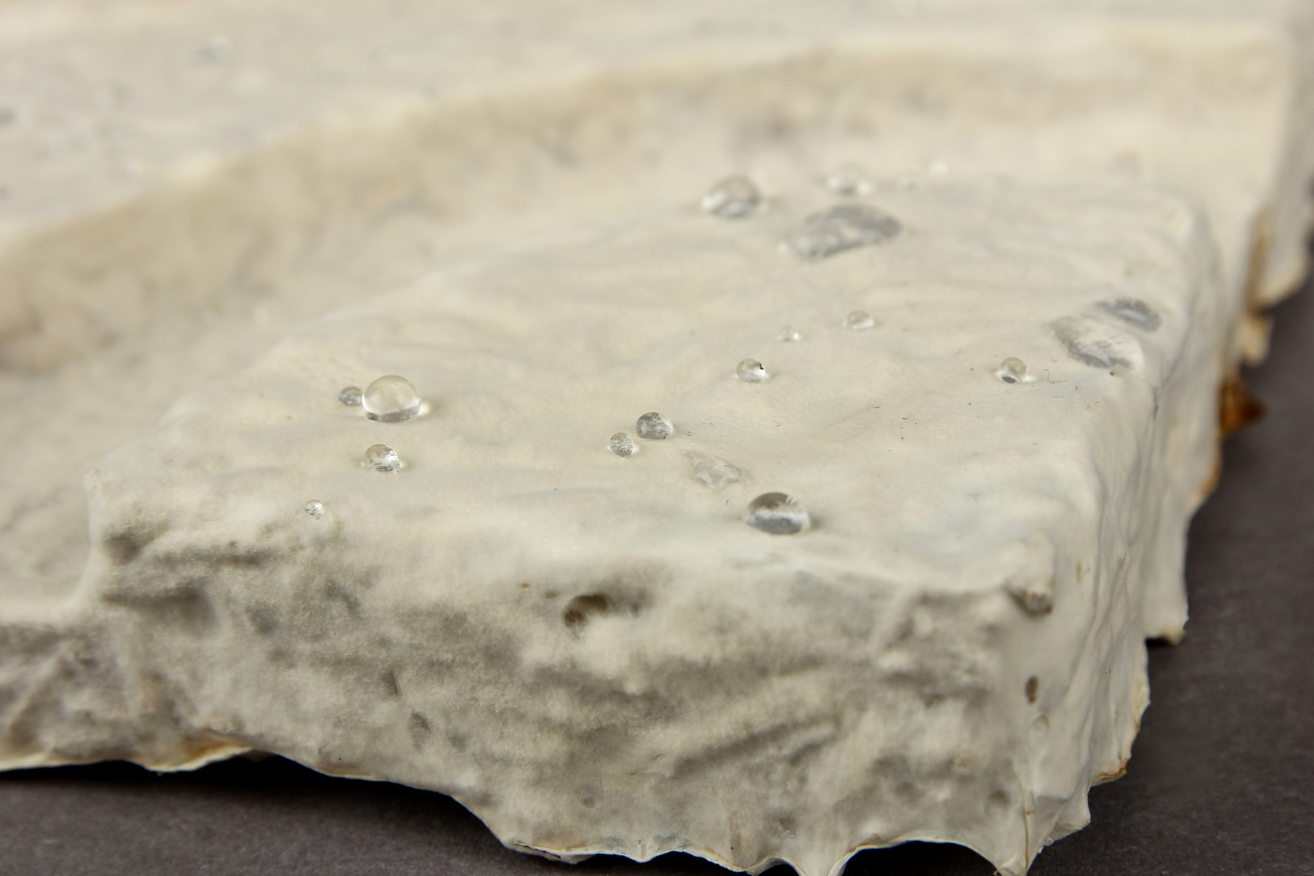
Our products: What we have already grown
“Grown i garage.
Ready for worl.

Slide 7
Our Products:
How We Compare
Feature | byMYCO | Polystyrene | Plastic | Cardboard
Biodegradability |  |  |  | but slow
Thermal Insulation
Soundproofing
Fire Resistance
Compost Safe

Slide 8
Market Opportunity:
A $1052.96 Billion Market… and Growing
CGAR = 4.2%
Regulation EU ban on single-use plastics
ESG: Growing demand for major brands

Slide 9
Business Model:
How We Make Money
Stream | Type | Comment
B2B Sales | Recurring | Premium cup, shell, panel
Product Licensing | Scalable | Decorative mold designs
MycoLeather Division | Future R&D | Fashion/textile partnerships
Co-branding / White Label | Strategic | Luxury cosmetics collaborations
“Our strategy turns threats into market barriers, shielding us from low-quality competition.”

Slide 10
Business Model:
Pilot Phase - Proof Through Production
Investor found
Timeline:
6 – 12 months
Steps:
Setup
Productton
LOI Fulfillment
Feedback Loop
Scale Readiness
Key Stats:
Production capacity: 6,000 liters/month
17,000 premium cups packages possible
3 LOIs signed
Target margin: 79%
Location: Poznań
Size: 200m² space
“Pilot = de-risked launchpad for full factory phase.”

Slide 11
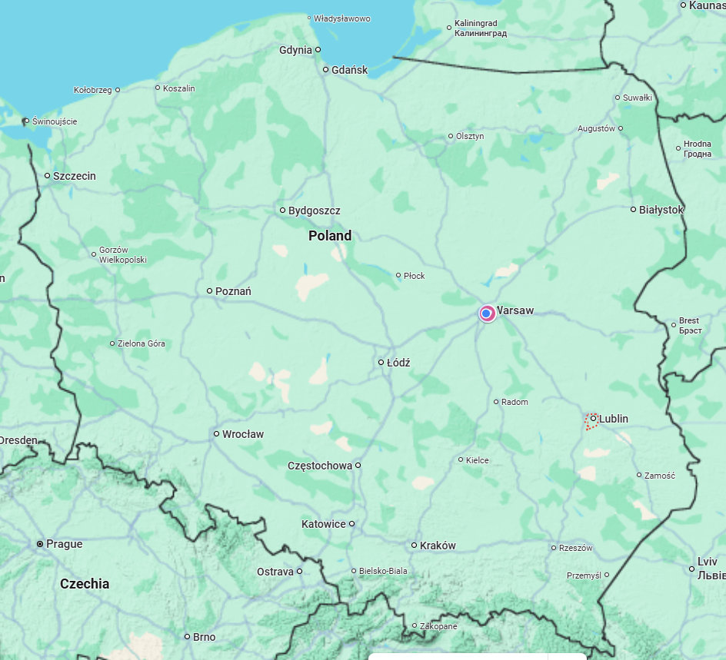
Business Model:
Phase 2 - Full Factory Production
Looking for Investor
Key Stats:
Production area: 1,000 m²
Capacity: 20,000 liters/month
Staff: 5 employees (production, lab, admin)
Time to break-even: up to 6 months
Min viable production: 7,600 liters/month
Lublin
“From garage to 60,000 products/month – this is where we scale.”

Slide 12
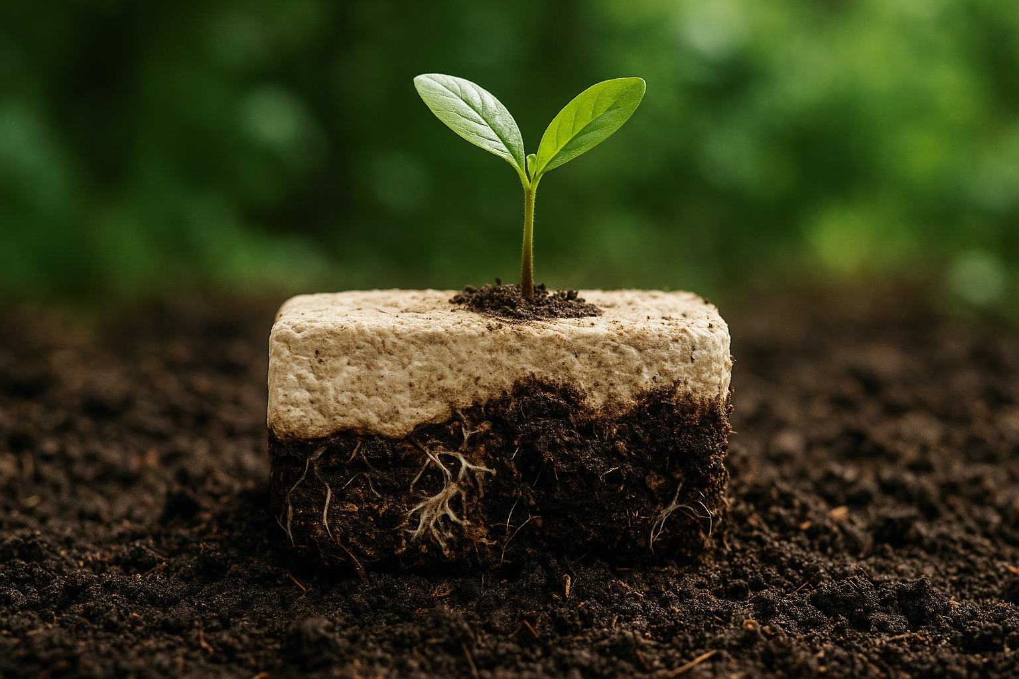
A Future Without Waste –
Grown by Nature
We are looking for contacts and clients for B2B relationships.
Invest with us and you will protect not only your wallet but also the planet!

